Slide 1
In The Name Of GOD
Pharmacological Therapy for T2DM
Fatemeh Rahmani.MD
Shahid Beheshti University of Medical Sciences

Slide 2
Treatment Goals for Adults with DM
● HbA1c <7.0%
● Pre-prandial blood glucose 80–130 mg/dL
● Post-prandial blood glucose <180 mg/dL
● HbA1c <6.5% Short duration of DM
DM treated with lifestyle or Metformin only long life expectancy
No significant CVD
● HbA1c <8.0% History of severe hypoglycemia
Limited life expectancy
Advanced micro or macrovascular complication
Long standing DM in whom the goal is difficult to achieve

Slide 3
Goals of Therapy
● eliminate symptoms related to hyperglycemia
● eliminate the long-term microvascular and macrovascular complications
● allow the patient to achieve as normal a lifestyle as possible
● attention to the conditions associated with DM (obesity, HTN, dyslipidemia, CVD)
Principles of Treatment
● Life style management (Nutrition Therapy, Physical Activity, Psychosocial Care)
● Diabetes self-management education and support
●Pharmacological treatment
● Surgical treatment

Slide 4
Pharmacologic Treatment of Diabetes
A patient-centered approach
● Efficacy
● Hypoglycemia risk
● CVD,CHF
● CKD
● Impact on weight
● Cost
● Side effect
● Patient preference

Slide 5
Case 1
A 52-year-old woman known case of T2DM from 3 years ago was evaluated for management of DM.
PMH: HTN, chronic stable angina, 2 times urinary tract infection in recent year
DH: Metformin 2gr, losartan 50mg, HCT 25mg
PH/Ex: BP:120/75 mmHg
BMI: 24 Kg/m2
1+ pitting edema in lower extremities
other review of system was unremarkable
Lab test: FBS:155 mg/dl , HbA1c: 8.3%
Cr: 0.9 mg/dl , LDL: 62 mg/dl

Slide 6
Which of the following should be added to control hyperglycemia?
A) Tab Empagliflozin 25 mg/d
B) Tab Gliclazide 60 mg/bid
C) Tab Pioglitazone 30 mg/d
D) Tab Acarbose 100 mg/d

Slide 7
Glucose-Lowering Agents
● Biguanide
● Insulin secretagogues: Sulfonylurea, Meglitinide
● Thiazolidinedione
● α-Glucosidase inhibitor
● GLP-1 receptor agonist
● Dipeptidyl peptidase IV inhibitor
● Sodium-glucose cotransporter 2 inhibitor
● Insulin

Slide 8
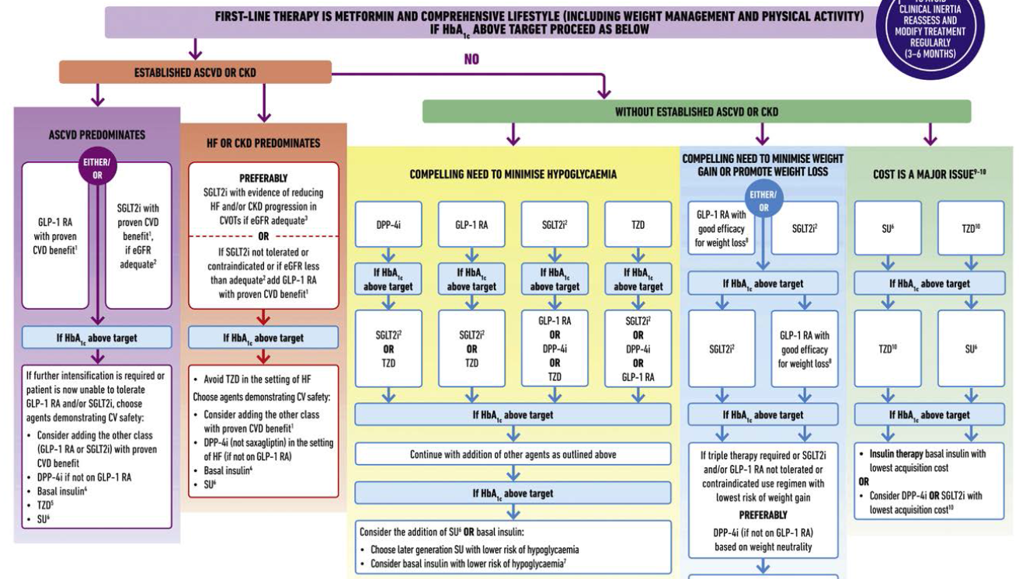

Slide 9
Combination Therapy
● Initial Dual therapy should be considered in patients with HbA1c >1.5-2 % above target
● Mild hyperglycemia (FBS <126–199 mg/dL) often respond well to a single, oral glucose-lowering agent
● Moderate hyperglycemia (FBS 200–250 mg/dL) usually require more than one oral agent

Slide 10
Glucose-Lowering Agents
● Biguanide
● Insulin secretagogues: Sulfonylurea, Meglitinide
● Thiazolidinedione
● α-Glucosidase inhibitor
● GLP-1 receptor agonist
● Dipeptidyl peptidase IV inhibitor
● Sodium-glucose cotransporter 2 inhibitor
● Amylin agonists
● Insulin

Slide 11
Biguanide : Metformin
● Mechanism: reduces hepatic glucose production, improves peripheral glucose utilization
● Reduces FBS and insulin levels, improves the lipid profile
● Efficacy: High (1-2 % HbA1c reduction)
● Hypoglycemia: No
● Weight change: Neutral
● ASCVD: potential benefit
● CHF: Neutral
● Renal effect :adjusted in GFR<60 contraindicated in GFR<45
●Side effect: GI intolerance(diarrhea, bloating, nausea)
Vit B12 deficiency lactic acidosis

Slide 12
Tab Metformin (Glucophage) 500 mg-1000 mg BID
Tab Metformin ER 500 mg-1000 mg BID
●Initial dose : 500 mg BID
●After 1-2 weeks increase to a maximally tolerated dose of 2000 mg/daily
Contraindication
● moderate renal insufficiency (GFR <45 mL/min), acidosis
● unstable CHF
● liver disease
● severe hypoxemia
● hospitalized patients
● patients who can take nothing orally
● receiving radiographic contrast material

Slide 13
Glucose-Lowering Agents
● Biguanide
● Insulin secretagogues: Sulfonylurea, Meglitinide
● Thiazolidinedione
● α-Glucosidase inhibitor
● GLP-1 receptor agonist
● Dipeptidyl peptidase IV inhibitor
● Sodium-glucose cotransporter 2 inhibitor
● Amylin agonists
● Insulin

Slide 14
Sulfonylureas
First-generation (chlorpropamide, tolazamide, tolbutamide)
● have a longer half-life
● greater incidence of hypoglycemia
● more frequent drug interactions(warfarin, aspirin, ketoconazole, α-glucosidase inhibitors, fluconazole)
● no longer used
Second-generation sulfonylureas
● have a more rapid onset of action
● better coverage of the postprandial glucose rise
● shorter half-life of some agents may require more than once-a-day dosing
Tab Glibenclamide 5 mg :2.5-10 mg/BID
Tab Gliclazide 30,60,80 mg: 80-160 mg BID
Tab Diamicron 30,60 mg/daidy

Slide 15
Sulfonylurea…
● Reduce both fasting and postprandial glucose
● type 2 DM of relatively recent onset (<5 years) with residual endogenous insulin production
● Initiated at low doses and increased at 1-2 week intervals based on SMBG
● Efficacy: High (1-2 % HbA1c reduction)
● Hypoglycemia: Yes (delayed meals, increased physical activity, alcohol intake, Renal failure)
● Weight change: Gain
● ASCVD: Neutral
● Renal failure: Glibenclamide : not recommended
Gliclazide : initiate conservatively to avoid hypoglycemia
\
● Cardioselctive Sus: glimepiride, gliclazide
● Contraindication : significant hepatic or renal dysfunction

Slide 16
Glinides
Tab Repaglinide (Newbet) 0.5mg/1 mg/2mg : 0.5-2 mg/TID
Tab Nateglinide 60-120 mg/TID
● Interact with the ATP-sensitive potassium channel
● Short half-life
● Immediately before each meal to reduce meal-related glucose excursions

Slide 17
Glucose-Lowering Agents
● Biguanide
● Insulin secretagogues: Sulfonylurea, Meglitinide
● Thiazolidinedione
● α-Glucosidase inhibitor
● GLP-1 receptor agonist
● Dipeptidyl peptidase IV inhibitor
● Sodium-glucose cotransporter 2 inhibitor
● Amylin agonists
● Insulin

Slide 18
Thiazolidinedione Tab Pioglitazone 15 mg,30mg, 45 mg/d
● Reduce insulin resistance by binding to the PPAR-γ
● Raises HDL and LDL / decrease TG
● FDA recommends measurement of liver function tests prior to initiating therapy
● Efficacy: High (0.75-1.5% HbA1C reduction)
●Hypoglycemia: No
●Weight change: Gain (Promote a redistribution of fat from central to peripheral locations)
● CHF effect: increased risk
● Renal dose adjustment : not required
● Side effect: Fluid retention (Peripheral edema and CHF, reduction in hematocrit)
Bone Fx, macular edema
● Contraindication : liver disease or CHF (class III or IV)

Slide 19
Glucose-Lowering Agents
● Biguanide
● Insulin secretagogues: Sulfonylurea, Meglitinide
● Thiazolidinedione
● α-Glucosidase inhibitor
● GLP-1 receptor agonist
● Dipeptidyl peptidase IV inhibitor
● Sodium-glucose cotransporter 2 inhibitor
● Amylin agonists
● Insulin

Slide 20
α- glucosidase inhibitors Tab Acarbose 25-50 mg TDS
● Reduce postprandial hyperglycemia
● Efficacy: Intermediate (0.5-1 % HbA1C reduction)
● Delay glucose absorption by inhibiting enzyme that cleaves oligosaccharides into simple sugars in the intestinal lumen
● Not affect glucose utilization or insulin secretion
● Initiation in low dose, evening meal, increased to a maximal dose over weeks to months
● Increase levels of sulfonylureas and increase the incidence of hypoglycemia
● In occurrence of hypoglycemia: consume glucose
● side effects : diarrhea, flatulence, abdominal distention
● Contraindication: IBD
Gastroparesis
Creatinine >2 mg/dL

Slide 21
Glucose-Lowering Agents
● Biguanide
● Insulin secretagogues: Sulfonylurea, Meglitinide
● Thiazolidinedione
● α-Glucosidase inhibitor
● GLP-1 receptor agonist
● Dipeptidyl peptidase IV inhibitor
● Sodium-glucose cotransporter 2 inhibitor
● Amylin agonists
● Insulin

Slide 22
GLP-1 receptor agonist
● PEN liraglutide (Victoza, Melitide) 0.6 mg -1.2 mg-1.8 mg/ SQ/ d
● Increase glucose-stimulated insulin secretion
● Suppress glucagon
● Slow gastric emptying
● Used alone or as combination therapy with metformin, sulfonylureas, TZD
● Use of insulin secretagogues require a reduction in these agents to prevent hypoglycemia
Short-acting GLP-1 RA: exenatide , lixisenatide provide mostly postprandial coverage
Long-acting GLP-1 RA: liraglutide, exenatide, albiglutide, dulaglutide, lixisenatide reduce both the postprandial and fasting glucose

Slide 23
GLP1 agonist …
● Efficacy: High (1-2 % HbA1c reduction)
● Hypoglycemia: No
● Weight change: Loss
● ASCVD: Benefit
● CHF: Neutral
● Cost: High
● Renal dose adjustment: Required
● Side effect: GI (nausea, vomiting, diarrhea)
Acute pancreatitis
Risk of MTC
● Contraindication: MTC, MEN syndrome, pancreatic disease

Slide 24
Glucose-Lowering Agents
● Biguanide
● Insulin secretagogues: Sulfonylurea, Meglitinide
● Thiazolidinedione
● α-Glucosidase inhibitor
● GLP-1 receptor agonist
● Dipeptidyl peptidase IV inhibitor
● Sodium-glucose cotransporter 2 inhibitor
● Amylin agonists
● Insulin

Slide 25
DPP-4 Inhibitors Tab Sitagliptin (Ziptin, januvia) 50 mg, 100 mg: 25-100 mg/d
Tab Linagliptin (Melijent ) 5mg/d
●Efficacy: Intermediate(0.5-1% HbA1C reduction)
● Preferential effect on postprandial blood glucose
● Hypoglycemia: No
● Weight change: Neutral
● ASCVD: Neutral
● Cost: High
● Renal dose adjustment: Required for Sitagliptin
Not for Linagliptin
●Side effect: Acute pancreatitis
●Contraindication: pancreatic disease
RF for acute pancreatitis ( heavy alcohol use, Hypertriglyceridemia , hypercalcemia)

Slide 26
Glucose-Lowering Agents
● Biguanide
● Insulin secretagogues: Sulfonylurea, Meglitinide
● Thiazolidinedione
● α-Glucosidase inhibitor
● GLP-1 receptor agonist
● Dipeptidyl peptidase IV inhibitor
● Sodium-glucose cotransporter 2 inhibitor
● Amylin agonists
● Insulin

Slide 27
SGLT2 Inhibitors
Tab Empagliflozin (Gloripa): 10 mg-25 mg/d
● Inhibits glucose reabsorption
● Lowers the renal threshold for glucose
● Increased urinary glucose excretion
● Glucose-lowering effect is insulin independent( Not related to changes in insulin sensitivity or secretion)
● Impair proximal reabsorption of sodium (diuretic effect)
● 3–6 mm Hg reduction in systolic blood pressure
● Inhibition of SGLT2 on alpha cell lead to increased glucagon and liver production of glucose and ketones

Slide 28
SGLT2 inhibitors…
● Efficacy: Intermediate (0.5-1 % HbA1C reduction)
● Hypoglycemia: No
● Weight change: Loss
● ASCVD: Benefit
● CHF: Benefit
● Cost: High
● Renal dose adjustment: required
● Side effect: Euglycemic DKA (volume depletion, hypotension)
Genitourinary infection
Bone fractures
Fournier gangrene

Slide 29
Combination Tablets
● Tab Sitagliptin-Metformin: 50-500 / QD,BID
50-1000/ QD,BID
● Tab Empagliflozin-Metformin: 5- 500 BID, 5-1000 BD
12.5-500 BID, 12.5-1000BID
● Tab Empagliflozin-Linagliptin : 10-5 /QD
25-5/QD
● Tab Linagliptin-Metformin : 2.5-500/QD,BID
2.5-1000/ QD,BID

Slide 30
Minimizing Cardiovascular risk
● initial use of Metformin
● GLP1 Agonist
● SGLT2 inhibitors
Not advised
● Sulfonylurea and Insulin are increasing Cardiovascular risk
● Pioglitazone increase the risk of CHF

Slide 31
Minimizing Hypoglycemia
● older patients with a long duration of DM
● cognitive impairment neuropathy
● a prior history of hypoglycemia requiring assistance by another person
● Metformin doesn’t cause hypoglycemia when used alone
● DPP4 inhibitors
● GLP1 agonists
● SGLT2 inhibitors
● TZD

Slide 32
Minimizing weight gain
● Diet and exercise
● Metformin as initial therapy
● GLP1 agonist
● SGLT2 inhibitors
● Surgical procedures
Not advised
● Sulfonylurea
● TZD
● Prandial Insulin
● Basal insulin is less likely to cause weight gain than prandial

Slide 33
Minimizing cost
● Metformin
● Sulfonylurea
● Pioglitazone
● Acarbose
● Human insulin

Slide 35
Case 1
A 52-year-old woman known case of T2DM from 3 years ago was evaluated for management of DM.
PMH: HTN, chronic stable angina, 2 times urinary tract infection in recent year
DH: Metformin 2gr, losartan 50mg, HCT 25mg
PH/Ex: BP:120/75 mmHg
BMI: 24 Kg/m2
1+ pitting edema in lower extremities
other review of system was unremarkable
Lab test: FBS:175 mg/dl , HbA1c: 8.3%
Cr: 0.9 mg/dl , LDL: 62 mg/dl

Slide 36
Which of the following should be added to control hyperglycemia?
A) Tab Empagliflozin 25 mg/d
B) Tab Gliclazide 60 mg/bid
C) Tab Pioglitazone 30 mg/d
D) Tab Acarbose 100 mg/d

Slide 37
Case 2
A 58-year-old woman is evaluated for management of type 2 DM. She has lost 3.2 kg by changing her diet and activity level.
PMH: hypertension, hyperlipidemia, chronic stable angina.
DH: aspirin, metformin, valsartan, metoprolol, atorvastatin
PH/EX : BP :125/70 mmHg
PR 74/min.
BMI : 28 kg/m²
Lab test: HbA1c level: 8%,
FBS 147 mg/dl
eGFR 87%,
Alb/cr ratio 15 mg/gr
LDL 100 mg/dL

Slide 38
Which of the following should be added to control hyperglycemia and lower her risk of a major atherosclerotic cardiovascular disease event?
A. Basal insulin
B. Empagliflozin
C. Gliclazide
D. Sitagliptin

Slide 39
Thyank you for your attention

